Slide 1
Survival Rate prediction in Breast Cancer By: K. Pooladvand

Slide 2
Abstract
Breast cancer, the most commonly diagnosed cancer among women in the USA, demands accurate survival rate estimation. This critical information plays a pivotal role in guiding patients, their families, and healthcare professionals toward informed decisions, financial planning, and personalized treatment strategies. Our project involved meticulous curation of data from over 300,000 patients (spanning 2011-2015) and rigorous exploratory analyses.
During this process, we conducted correlation, Fisher, and Chi-square analyses to identify the most crucial parameters. From the original 36 features extracted using SEER *STAT software, we pinpointed 16 essential variables. The data underwent thorough examination and preparation, including specialized encoding techniques such as one-hot. Dealing with large databases, handling missing values, and selecting the right tools were some of the challenges we encountered and valuable lessons we learned.
Subsequently, we divided the cleaned and prepared dataset and applied machine learning techniques, including random forest, logistic regression, and deep neural network. Our approach addressed complexities related to both categorical and numerical variables, as well as handling missing data. Random Forest demonstrated better accuracy and acceptable speed in predicting breast cancer patient survival rates.
While our model is not intended for clinical use and lacks the rigor of a scientific investigation, it showcases remarkable success in estimating survival rates based on the training data. Furthermore, we extended its application to previously unseen databases from 2019-2022, comprising over 133,000 cases, allowing us to compare survival predictions against the next available dataset in the SEER program.

Slide 3
Problem Statement: Predicting Breast Cancer Survival Rates
Leveraging the SEER database (2011-2015), our mission is to train a machine learning model with ambitious objectives:
Exceptional Accuracy: Our aim is not only to surpass the 75% survival rate benchmark but also achieve accuracy levels exceeding 96%.
Critical Parameter Exploration: We will delve into 16 influential factors (such as race and cancer type) that impact survival. These parameters will be instrumental in training our model effectively.
This project serves as a vital link between data science and patient care, empowering informed decisions.
Our approach involves statistical analyses to identify crucial parameters and evaluate their dependencies.
Notes:
SEER stands for Surveillance, Epidemiology, and End Results. It is a program of the National Cancer Institute (NCI) in the United States.

Slide 4
Intro – What & Why
670,000 have lost their life to breast cancers globally in 2022 (43,700 in USA)
Breast cancer was the most common cancer in women in 157 countries out of 185 in 2022
Breast cancer is the most diagnosed cancer among U.S. women.
It is also personal to me.
Accurate survival prediction is critical for patient management
Precise survival estimates help allocate healthcare resources effectively
Patients and their families can make informed decisions about treatment options.
Quality of Life Considerations
And Economic consideration.

Slide 5













How - Flowchart
Choose the relevant parameters
Import datasets from SEER
Perform EDA for the datasets (two 2011-2015 and 2019-2022)
Find Statistically critical parameters among (16)
Modeling
Evaluate
Data preparation
Notes:
s

Slide 6
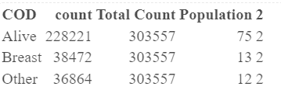
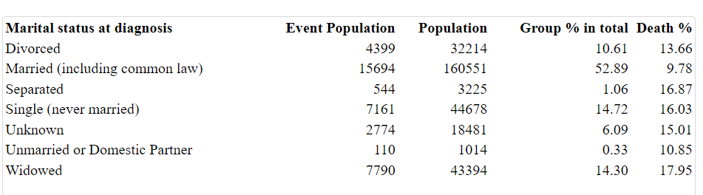
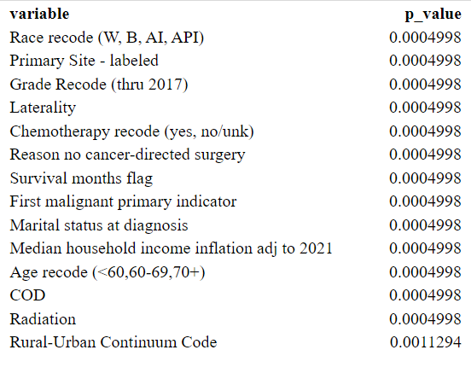
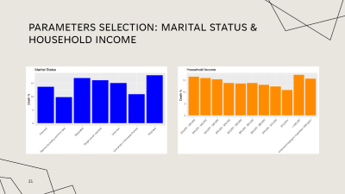
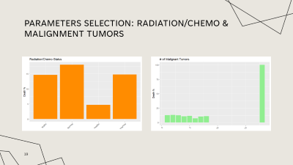
Data Display and Preliminary Analyses
Survival rate 2011-2015 of 300K: 75%
Principal Parameter selection
Evaluation the data, empty, correlation analyses, normality analyses,
Among 36 parameters 16 found critical: treatment (chemo/radiation, surgery), # tumors, months from diagnosis to treatment, race, grade, and type
Data were analyzed using bootstrapping and random sampling to avoid the size using Chis-square and Fisher exact test
Many collinearities were identified and removed like sex, Origin Recode, Diagnostic confirmation, …
Marital status and survival
Fisher Exact with simulation.p.value=TRUE due to size of the sample!

Slide 7
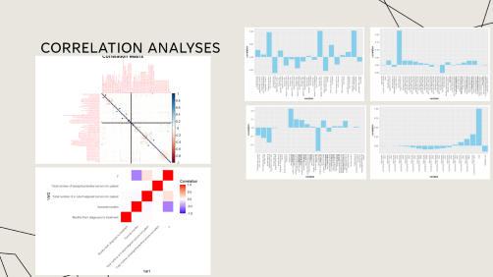
Hypothesis/correlation evaluation
Unimportant (Total of 16) | Important (total of 16)
Different race related indicators were in the data base (all removed expect one) | (+)Months from diagnosis to treatment
Sex | (-) Total number of in situ/malignant tumors for patient
Patient ID | (-) Total number of benign/borderline tumors for patient
Year of death (the survival month exists) | Age
Sequence number | Race (W, B, AI, API)
Year of diagnosis | Primary Label
Rural urban continuum | Grade
 | Treatment (Radiation/Surgery/Chemo)
 | Income
 | Marital Status
Summary
Many collinearity have found and remove from the data
Stepwise correlation analyses was performed to removed unimportant and poorly correlated parameters such as
Both numerical and categorical data were analyzed for correlation analyses
Dealing with categorical data was challenging specifically encoding the data for analyses
Notes:
"Sex", "Year of diagnosis", "Race and origin recode (NHW, NHB, NHAIAN, NHAPI, Hispanic)", "Site recode ICD-O-3/WHO 2008", "Site recode ICD-O-3 2023 Revision", "Diagnostic Confirmation, Survival months flag", "COD to site recode", "Patient ID", "Year of follow-up recode", "Year of death recode", "SEER other cause of death classification", "RX Summ--Systemic/Sur Seq (2007+)", "Origin recode NHIA (Hispanic, Non-Hisp)", "Race and origin (recommended by SEER)", "Diagnostic Confirmation", "Sequence number", "Radiation recode"

Slide 8
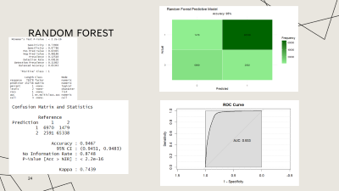
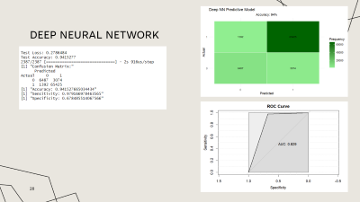
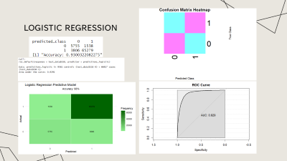
Data Analyses, Evaluation, & Summary
Method | Accuracy (Survival)
Logistic Regression | 93%
Random Forest | 94%
Deep Neural Network | 94%
Summary
Random Forest was the easiest to apply and reasonably fast
Logistic Regression was the fast, but still accurate
The accuracy of 94% and 93% for RF and Logistic Regression were achieved.
Logistic regression was easier to apply compared to Random Forrest.

Slide 9
Conclusion
A combined categorical and numerical data collected by SEER can be used for survival prediction of breast cancer with acceptable accuracy of 94%.
Random Forest Simplicity: Opt for user-friendly models like Random Forest.
Logistic regression is a powerful and reliable tool for a quick and relatively accurate survival rate estimate.
Correlation analyses of the large database including categorical data is challenging.
For this sort of problem Neural Network did not offer a better result than random Forrest.

Slide 10
References:
[1] SEER (https://seer.cancer.gov/data/access.html)
[2] zgalochkina/SEER_solid_tumor: R code for SEER data analysis of solid tumor in different populations (github.com)
[3] XAI_Healthcare_eXplainable_AI_in_Healthcare.pdf (upc.edu)
[4] Pargen, F., Pfisterer, F., Thomas, J., Bischl, B.: Regularized target encoding out performs traditional methods in supervised machine learning with high cardinality features. Computational Statistics 37(5), 2671–2692 (Nov 2022)
[5] American Cancer Society - Breast Cancer Survival Rates
GitHub: koohpi/Breast_Cancer_Survival_Project: A non-scientific project for breast cancer survival rate estimate in women based on SEER DB (github.com)
Rpub: RPubs - Breast Cancer Survival Rate With SEER

Slide 11

Thank you
Koohyar Pooladvand
koohyar.pooladvand69@cuny.spsmail.edu
?

Slide 12
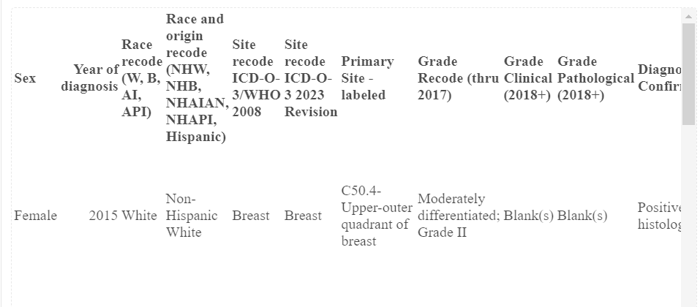
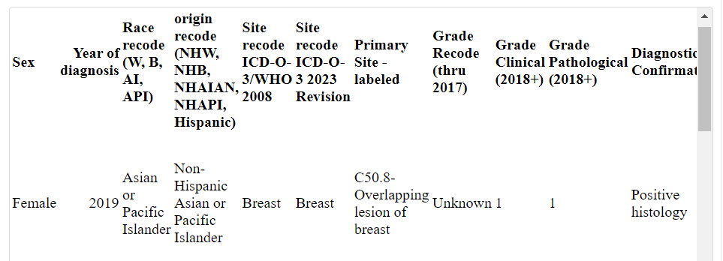
Imported data

Slide 13
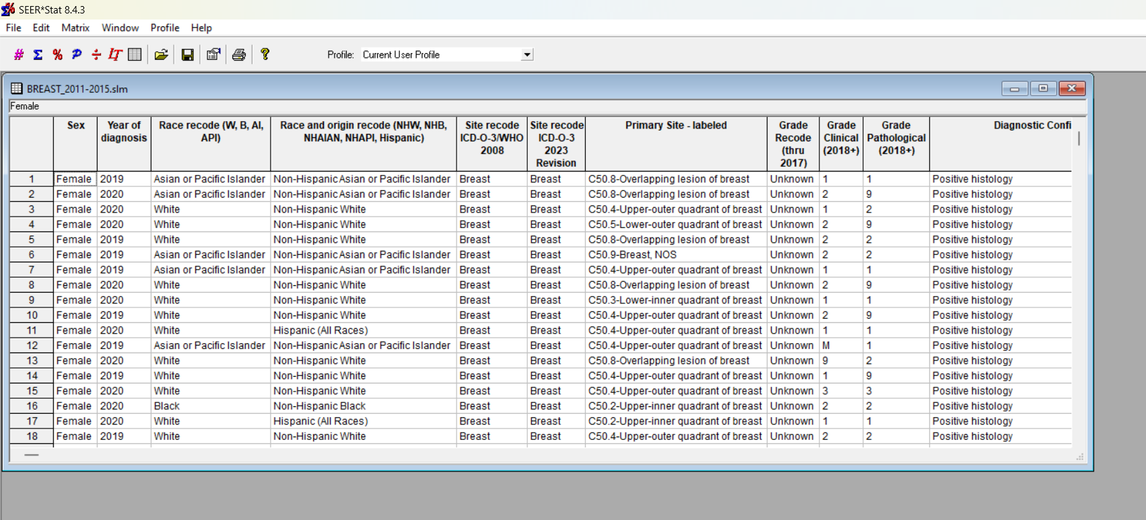
SEERSTAT App

Slide 14
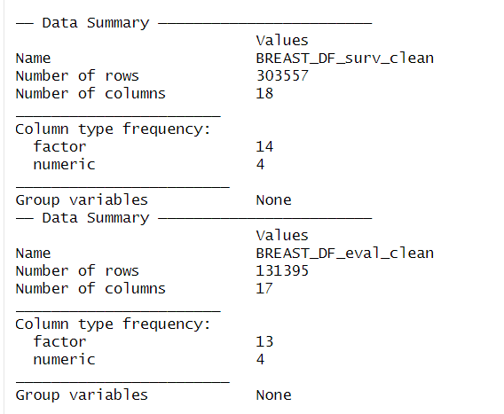
Cleaned/Tidy Data summary

Slide 15
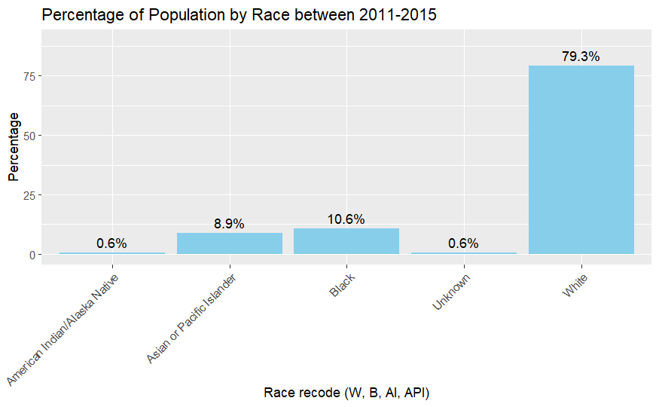
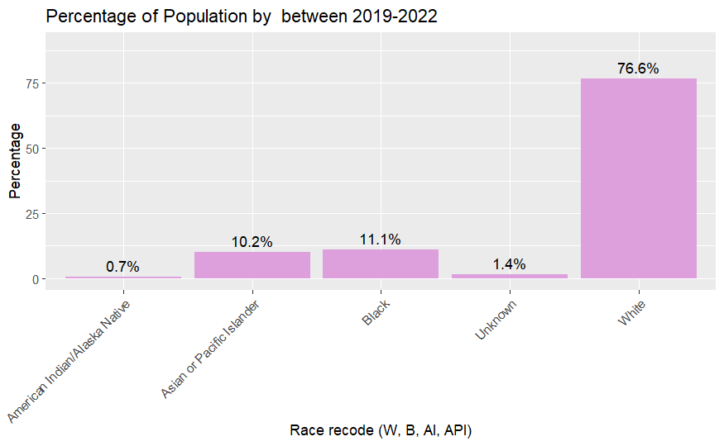
Race

Slide 16
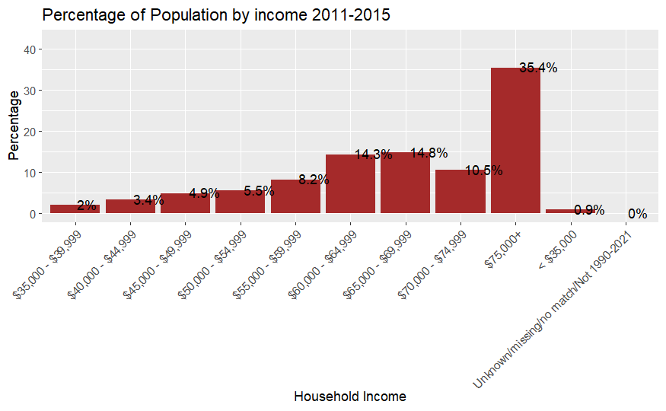
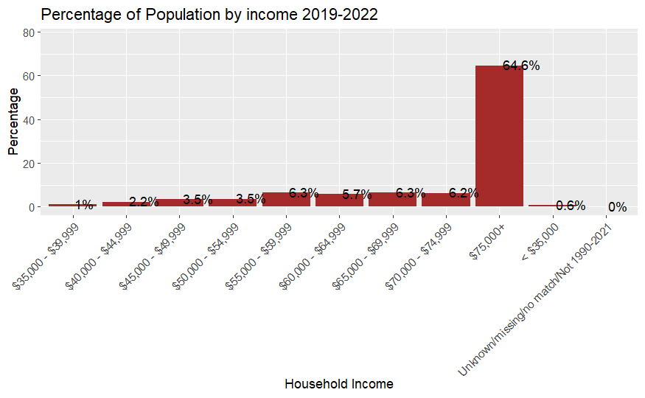
Households income

Slide 17
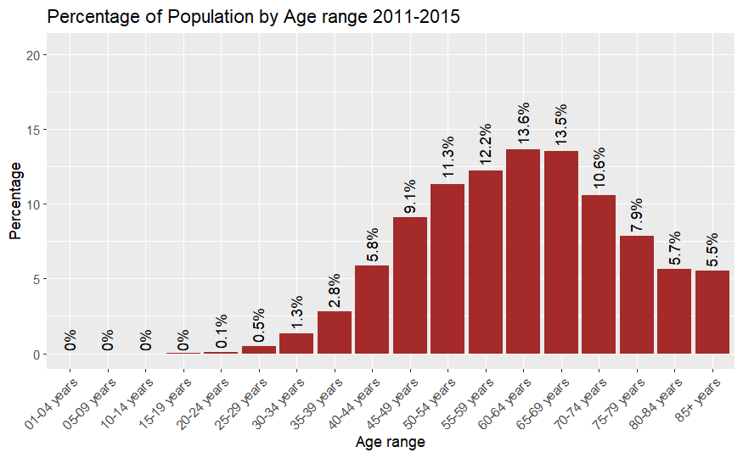
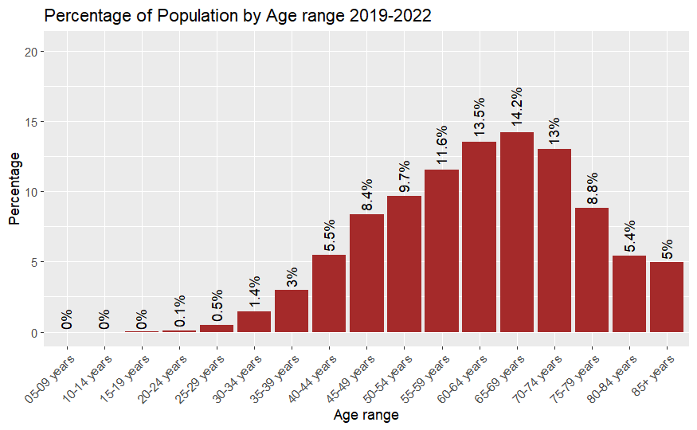
Cancer Age Distribution

Slide 18
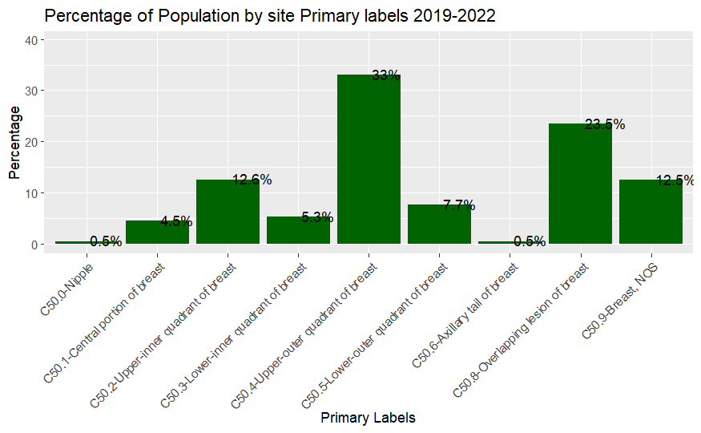
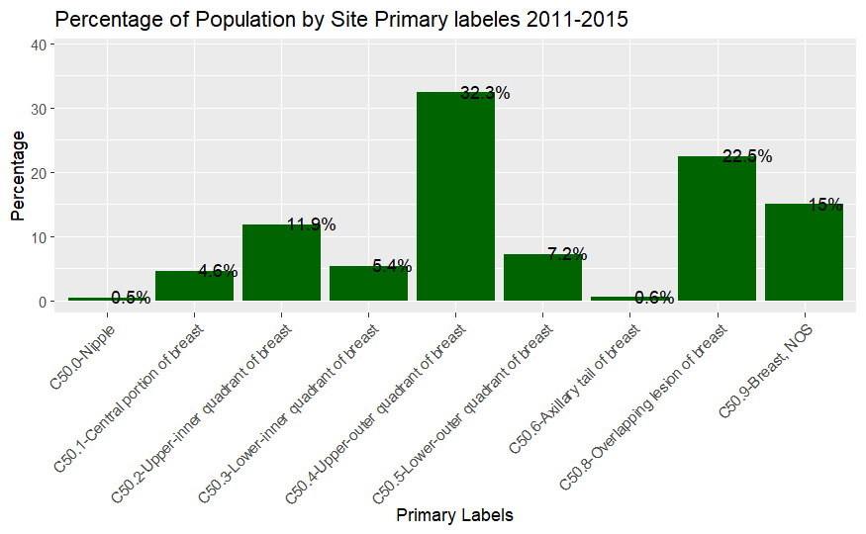
Cancer Primary Site Labels

Slide 19
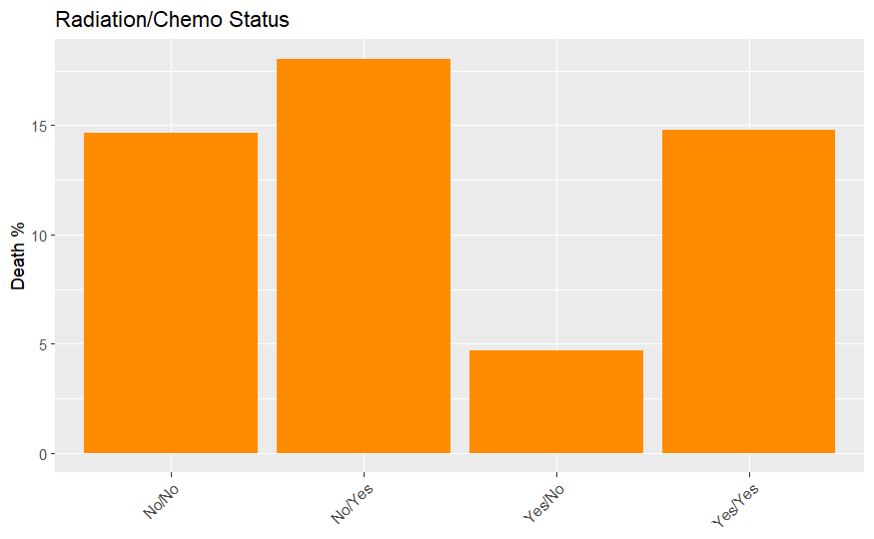
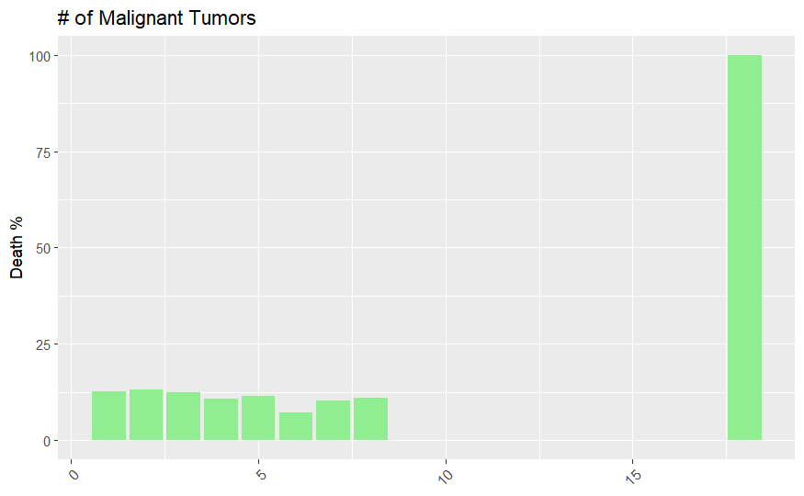
Parameters selection: Radiation/Chemo & Malignment tumors

Slide 20
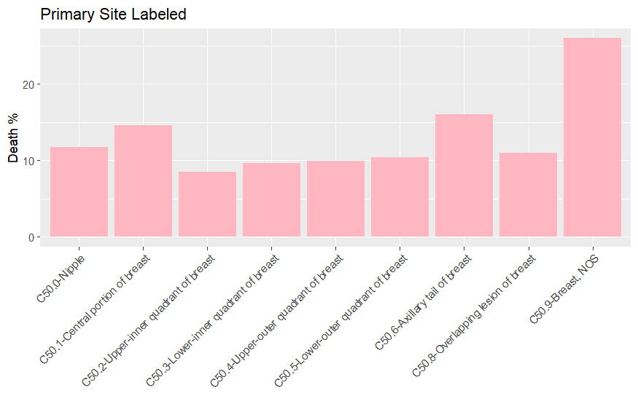
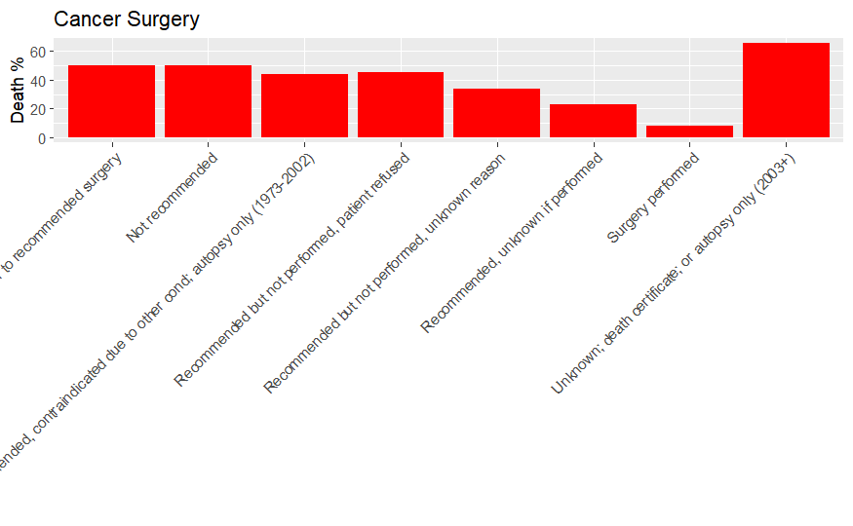
Parameters selection: Primary site & Surgery

Slide 21
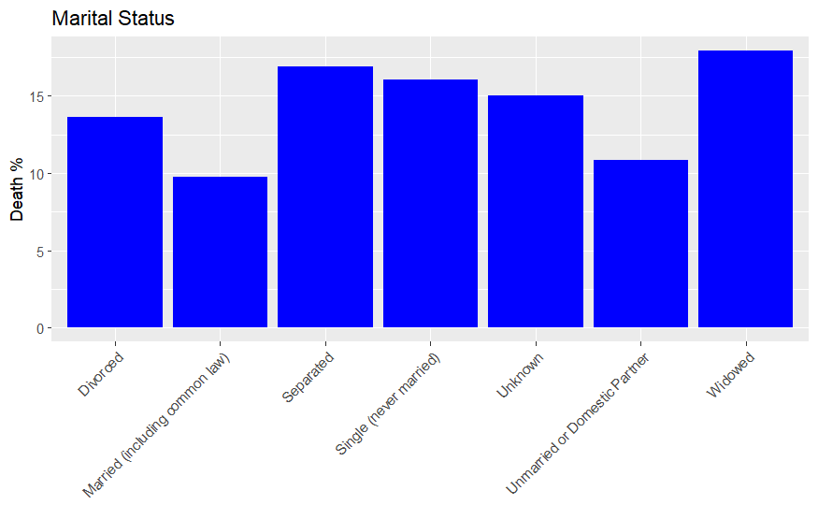
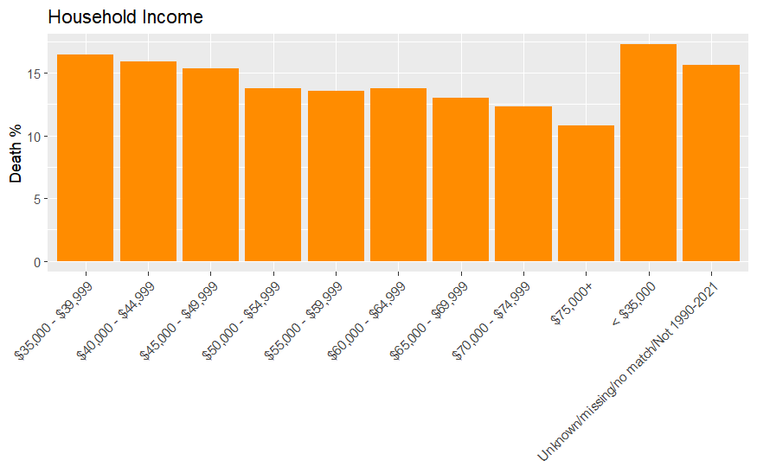
Parameters selection: Marital Status & Household income

Slide 22
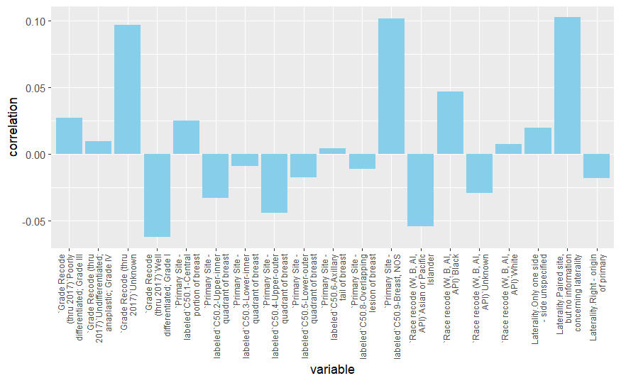
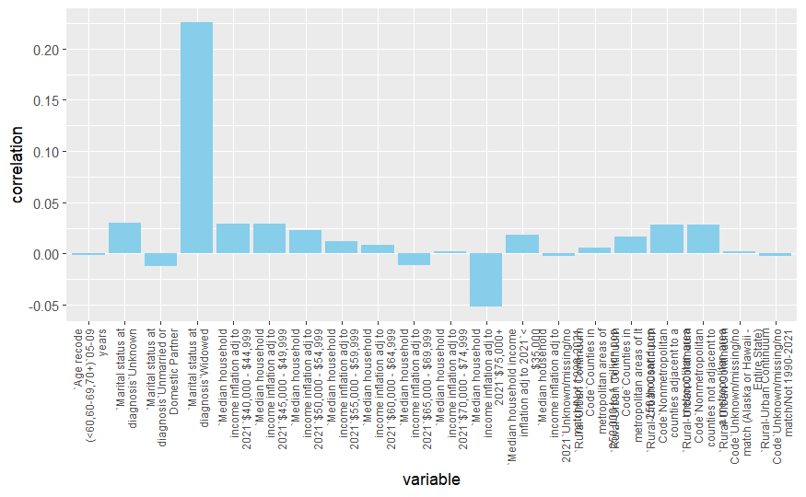
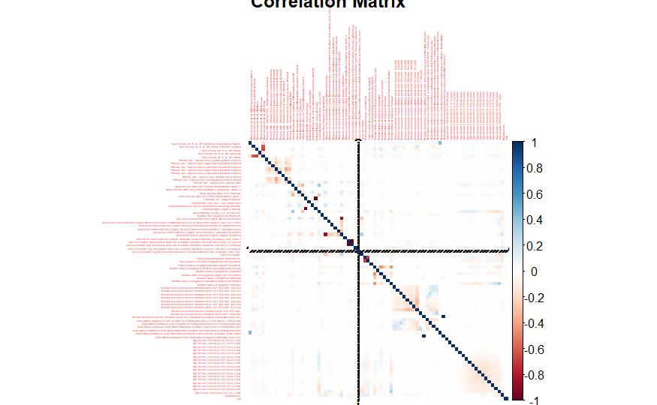
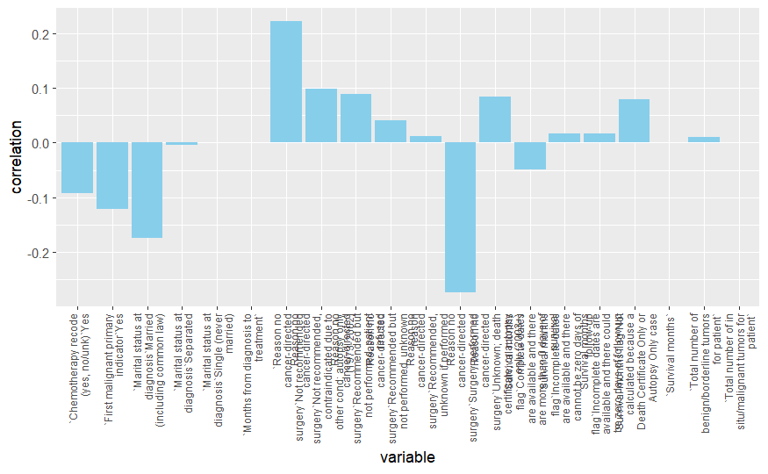
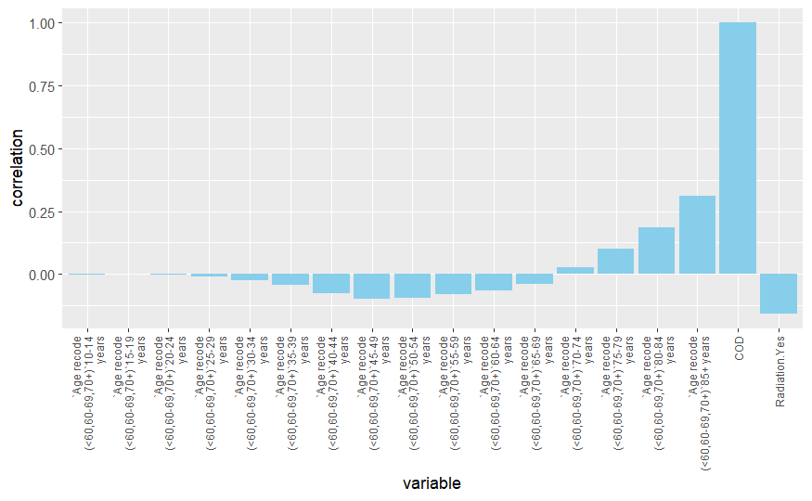
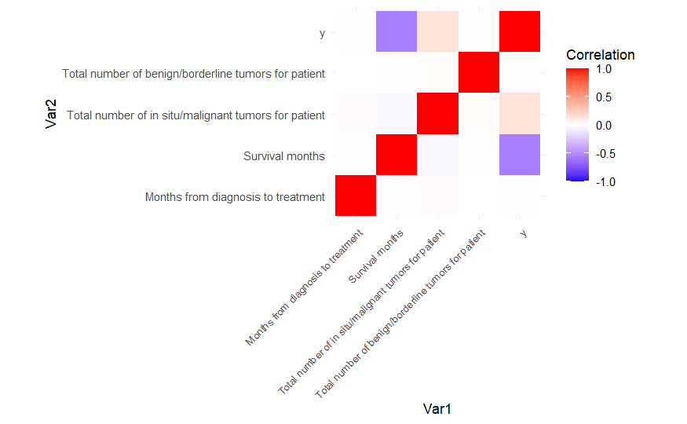
Correlation Analyses

Slide 23
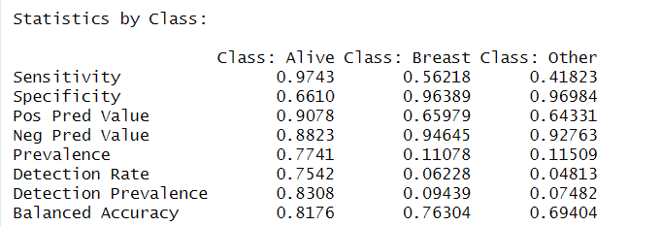
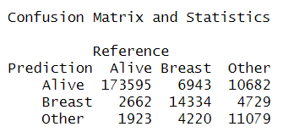
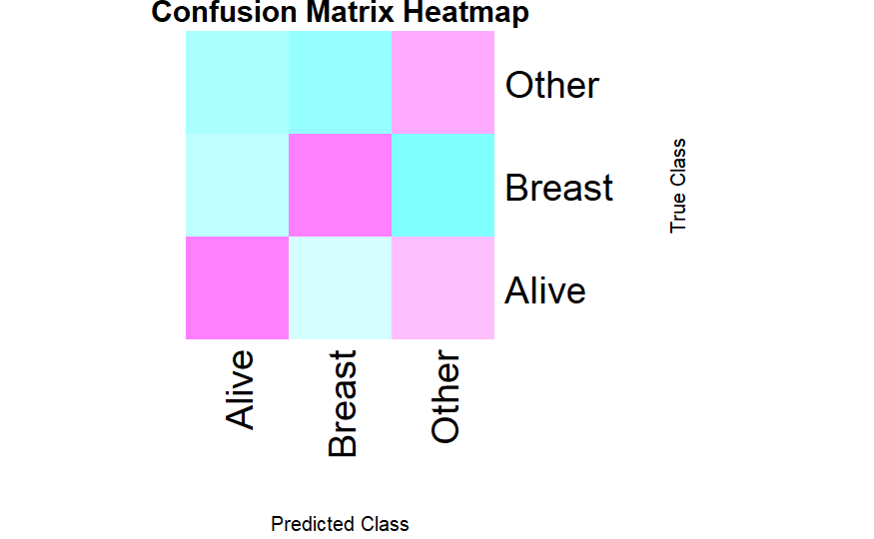
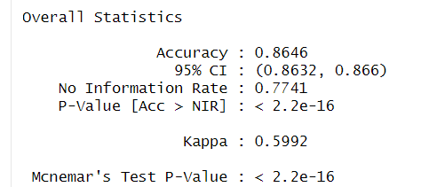
Random Forest

Slide 24
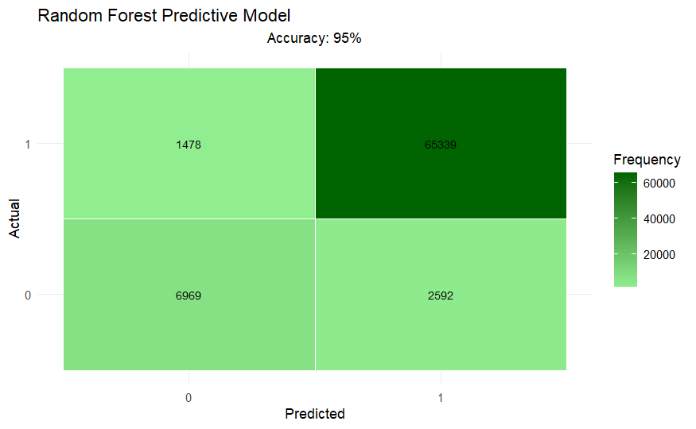
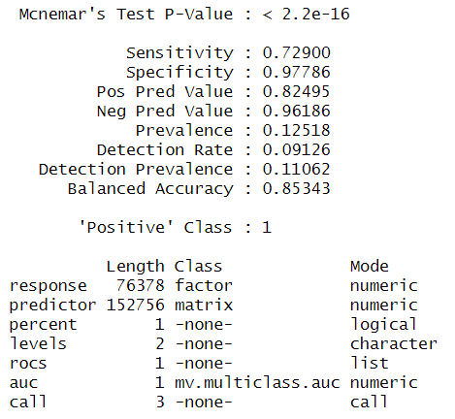
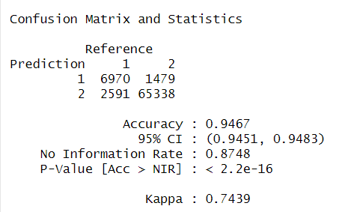
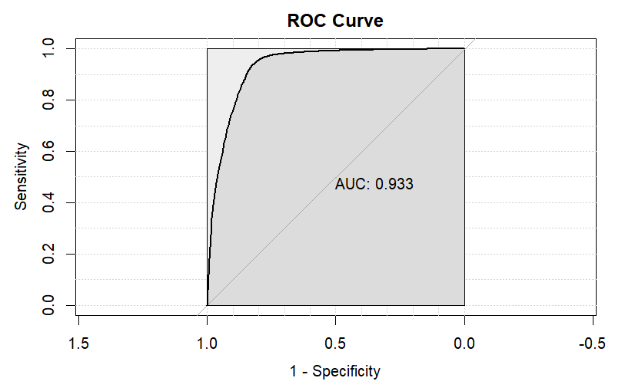
Random Forest

Slide 25
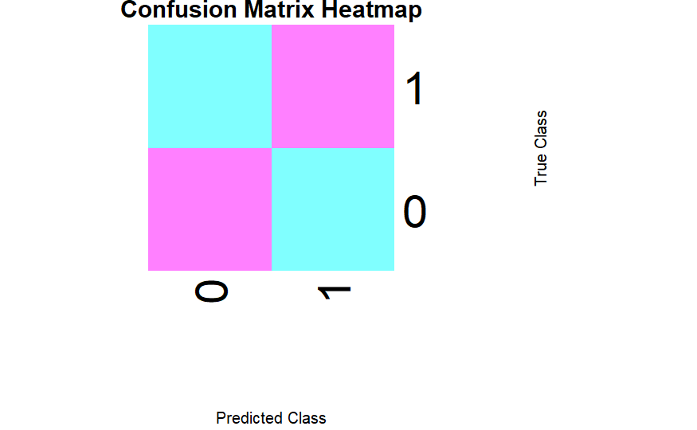

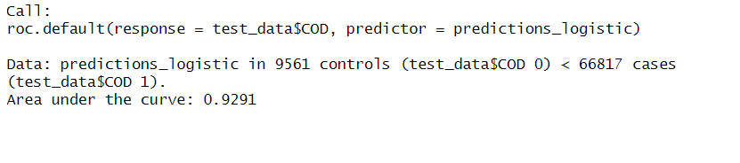
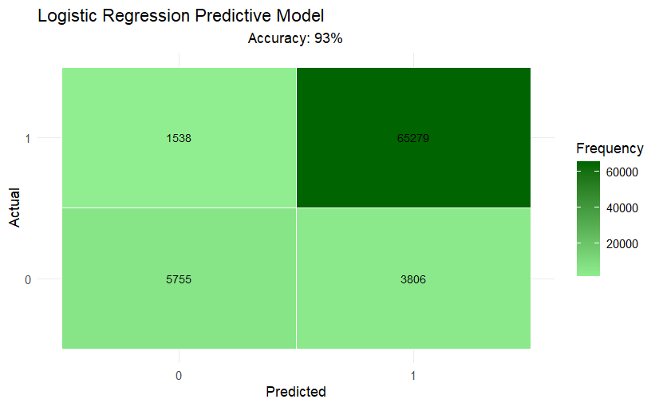
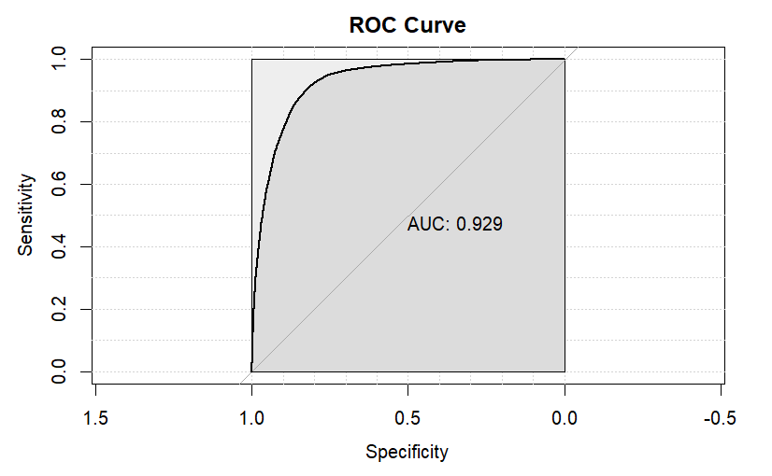
Logistic Regression

Slide 26
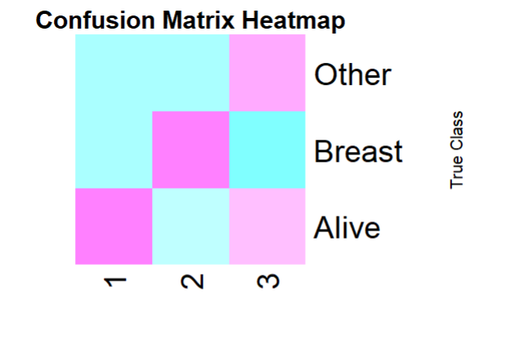
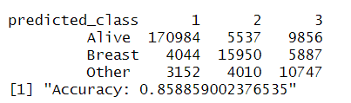
Gradient Boosting (gbm)

Slide 27
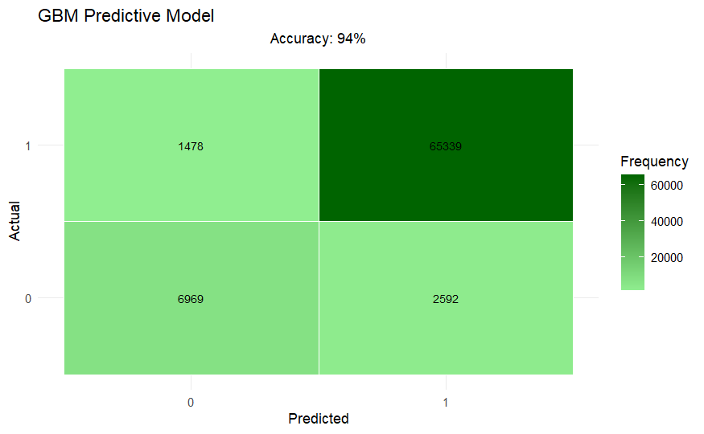
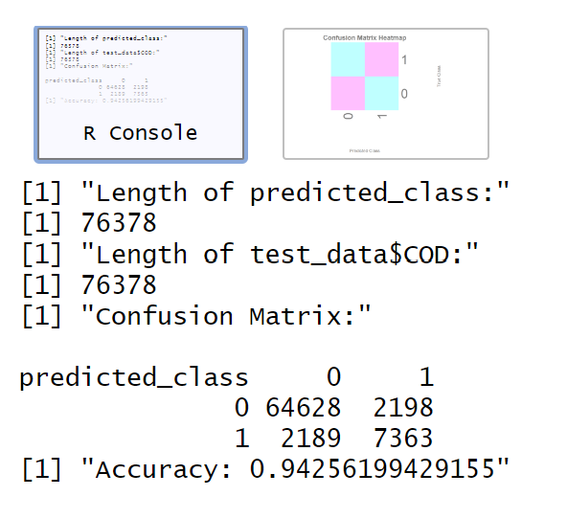
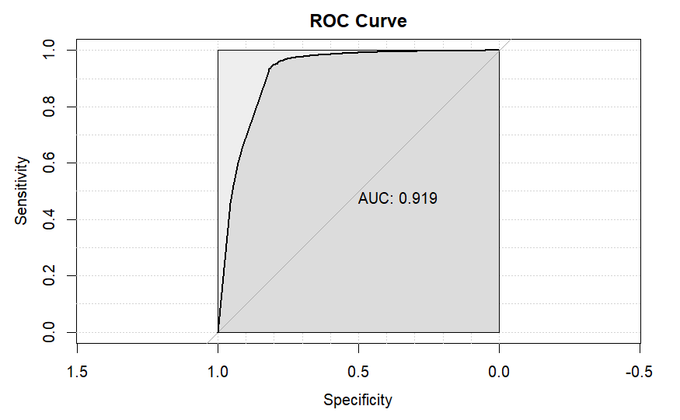
Gradient Boosting

Slide 28



Deep Neural Network

